Slide 2
Resume of the extention of bow-tie model
SORA
Safety Threats
(accidental origin)
OSOs(*)
UAS operation out of control
Harms
Cyber Security threats
(Malicious intention)
OCSOs (**)
Issue de Safety
Issue de Sécurité
New
component
(*) OSO: Operational Safety Objective
(**)OCSO: Operational Cyber Security Objective

Slide 3
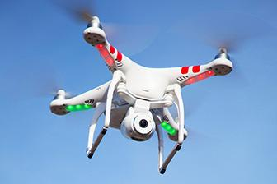
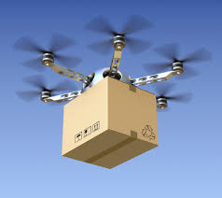
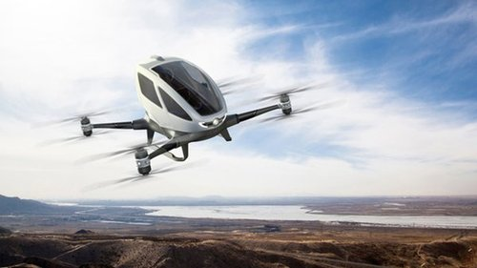
Open category
(Low risk)
Specific category
(Medium risk)
Certified category
(High risk)

Slide 4
Extended bow-tie model bow-tie model with new harm category
SORA
Fatal injuries to 3e parties on ground
OSO
Threats
Hazard
(UAS operation out of control)
Fatal injuries to 3e parties in air
Digital damage to infrastructure
New
component

Slide 5
Likelihood of fatal injuries to 3e parties on ground
Likelihood of having UAS operation out of control
(1)
Likelihood of person struck by the UA if the operation is out of control
(2)
Likelihood that, if struck, person is killed
(3)
=
x
x
Likelihood of fatal injuries to 3e parties in air
Likelihood of having UAS operation out of control
(1)
Likelihood of other A/C struck by the UA if the operation is out of control
(2)
Likelihood that, if struck, the other A/C cannot continue a safe flight and landing
(3)
=
x
x
Likelihood of digital damage to the Digital infrastructure
Likelihood of having UAS operation out of control
Likelihood of digital security violation if the operation is out of control
Likelihood that, if a successful violation,
the digital infrastructure is damaged
=
x
x
Likelihood of privacy invasion for 3e parties
Likelihood of having UAS operation out of control
(1)
Likelihood of person exposed to UA if the operation is out of control
(2)
Likelihood that, if exposed, privacy of person is violated
(3)
=
x
x
Notes:
Pour vous expliquer les processus de SORA. Je vais commercer par la approche qualitative de SORA.
Je vous rappelle: l’objective est de détérminer des OSO pour que les likelihood de 2 harm soit acceptable.

Slide 6
Risk evaluation table
VERY HIGH
HIGH
MEDIUM
LOW
SEVERITY LIKELIHOOD | LOW | MEIDUM | HIGH | VERY HIGH
NON - ACCEPTABLE
ACCEPTABLE

Slide 7
Extended model with new CS threats
Technical issues
Human errors
Adverse operating condition
Deterioration of external systems supporting UAS
Fatal injures to third parties on ground
OSOs
UAS operation out of control
Harm barriers
OCSOs
Fatal injure to third party in air
Attack on communication
Attack on Software
Attack on Sensors

Slide 8
Resume of the extention of bow-tie model
CONOPS
description
GRC determination
Ground risk > 7 ?
No
ARC determination
Yes
SAIL Level determination
OSO robustness determination
Operation modification
Input for system design

Slide 9
CONOPS
description
GRC determination
Integrated process
Ground risk > 7 ?
Yes
No
ARC determination
DIRC determination
(module 2)
SAIL Level determination
(Module 2)
CSC Determination
(Module 1)
OSO robustness determination
OCSO robustness determination
(Module 1)
Operation modification
Input for system design

Slide 10
CONOPS
description
GRC determination
Ground risk > 7 ?
Proposed Eextended workflow in module 2
Yes
No
ARC determination
DIRC determination
(Module 1)
SAIL Level determination
(Module 1)
Operation modification

Slide 11
CONOPS
description
GRC determination
Ground risk > 7 ?
Proposed Eextended workflow in module 2
Yes
No
ARC determination
PRC
determination
(Module 1)
SAIL Level determination
(Module 1)
Operation modification

Slide 12
CONOPS
description
Proposed Eextended workflow in module 2
GRC determination
Ground risk > 7 ?
Yes
No
ARC determination
PRC
determination
(Module 1)
SAIL Level determination
(Module 1)
Operation modification

Slide 13
CONOPS
description
GRC determination
Ground risk > 7 ?
Yes
No
ARC determination
PRC determination
(Extension 1)
SAIL Level determination
(Extension 1)
Operation modification

Slide 14
SAIL Level determination
Proposed Eextended workflow in module 1
CSC Determination
(Module 1)
OSO robustness determination
OCSO robustness determination
(Module 1)
Input for system design

Slide 15
3. Spirit of assessment method in quantitative approach
a. Likelihood of « Fatal injuries to 3e parties on ground »
Likelihood of digital damage to the Digital infrastructure
Likelihood of having UAS operation out of control
Likelihood of digital damage digital infrastructure if UAS operation out of control
=
x
Notes:
Pour vous expliquer les processus de SORA. Je vais commercer par la approche qualitative de SORA.
Je vous rappelle: l’objective est de détérminer des OSO pour que les likelihood de 2 harm soit acceptable.

Slide 16
Extended model with new CS threats
Technical issues
Fatal injures to third parties on ground
OSOs
Human errors
OSOs
UAS operation out of control
Adverse operating condition
OSOs
Fatal injure to third party in air
Deterioration of external systems supporting UAS
OSOs

Slide 17
Technical issues
Fatal injures to third parties on ground
Human errors
UAS operation out of control
Adverse operating condition
Fatal injure to third party in air
Deterioration of external systems supporting UAS
Threat
Hazard
Harm

Slide 18
Résumé du sujet de discussion
2. Les modules d’extensions de SORA ver Cyber-Security (CS)
Technical issue with UAS
OSO
Fatal injuries to 3e party on ground
Deterioriation of external supporting system
OSO
Human error
OSO
UAS operation out of control
Fatal injuries to 3e party in air
OSO
Harm barrier(s)
Aircraft in collision course
Adverse weather condition
OSO
Module 1
Module 2
Fatal digital damage to the Digital Infrastructure
Cyber-security threat
OCSO
Notes:
Tout d’abord, je vous rappelle 2 défintions importantes utilisé par SORA.
+ Risque, comme tous les norme dans domain aéronautique, risque d’un occurrence est un variant de 2 dimensions contient likelihood et severity de cette occurent
+ 2e définition, c’est modèle bow-tie ou nœud papillon. C’est un graphique utilisé pour représenter les scénarios qui peuvent arriver. Chaque scénario contient 3 occurrences: threat, hazard and harm. Threat entraine Hazard, Hazard entraine harm. Il y a aussi 2 petite bloque Threat barrier et Harm barrier qui représente les contre-mesure: threat barrier diminue likelihood de threat/hazard, Harm barrier diminue likelihodd de harm.

Slide 19
Extended model with new CS threats
Technical issues
Fatal injures to third parties on ground
Human errors
Adverse operating condition
Fatal injure to third party in air
Deterioration of external systems supporting UAS
OSOs
Harm barriers
UAS operation out of control
Module 2
Module 1
OCSOs
Cyber security threats
Damages to Infrastructure and Privacy violation
Threat side
Harm side

Slide 20
Extended model with new CS threats
Technical issues
Fatal injures to third parties on ground
Human errors
Adverse operating condition
Fatal injure to third party in air
Deterioration of external systems supporting UAS
UAS operation out of control
Extension 2
Extension 1
Cyber security threats
Damages to Infrastructure and Privacy violation
Threat
Harm

Slide 21
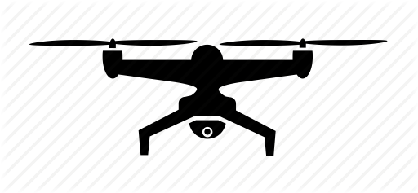
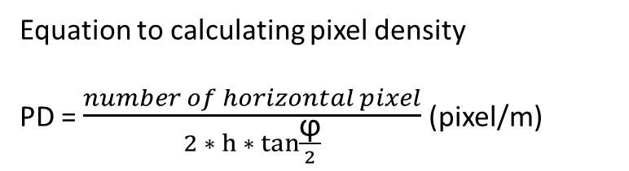
Equation to calculating pixel density
PD = $\frac{number of horizontal pixel}{2∗ h ∗ tan{\frac{\text{ϕ}}{2}}}$ (pixel/m)
h (m): altitude of drone
ϕ : angel of view of camera
ϕ
h

Slide 22
Extend the method SORA for privacy consequences
(b) How to evaluate Privacy Risk Class (PRC) of a given UAS operation?
Determine PRC
Type of operation | Unpopulated zone, VLOS | Unpopulated zone, BLOS | Populated zone, VLOS | Populated zone, BLOS
Level of detail of image
Monitor | A | B | C | D
Detect (>25 pixels/m) | B | B | 1 | 1
Observe (>62.5 pixels/m) | C | 1 | 1 | 1
Recognize (>125 pixels/m) | D | 1 | 1 | 2
Identity (>250 pixels/m) | E | 1 | 2 | 2
Inspect (>1000 pixels/m) | 1 | 2 | 2 | 2

